Slide 1
Salt-and-Pepper noise removal based on FPGA
Presented by
汤行舟，周乾坤， 徐泽诚
1

Slide 2
CONTENTS
02
04
Project
Background
Project
Procedure
Conclusion
Project
Design
Problems
And
Solutions
01
03
05
2

Slide 3
01
Project Background
3

Slide 4
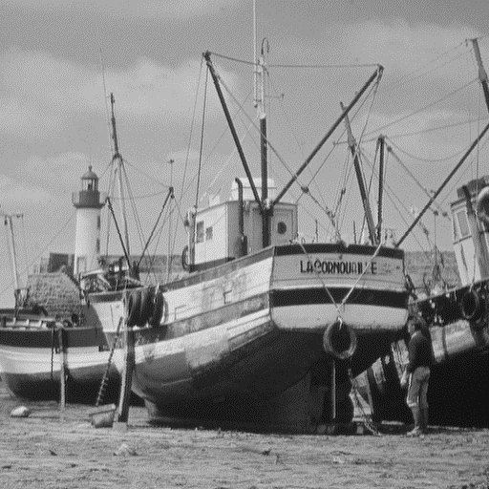
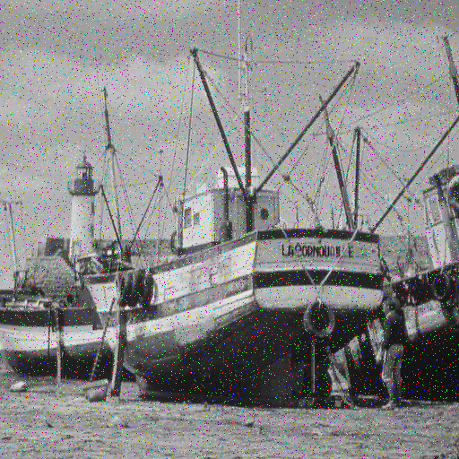
Salt-and-Pepper Noise
In digital images
Caused by sharp and sudden disturbances
Randomly occuring white and black pixels
Extremely high or low intensity
4

Slide 5
02
Project Design
5

Slide 6
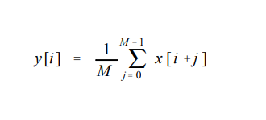
Filter Choose: Why not Moving-average Filter?
Average noise is not necessarily zero！
6

Slide 7
Filter Choose: Median Filter
Salt-and-pepper noise
Solution: Median filter
Advantage:
1. Effective in removing noises
2. Good preservation of details
3. Easy to implement
7

Slide 8
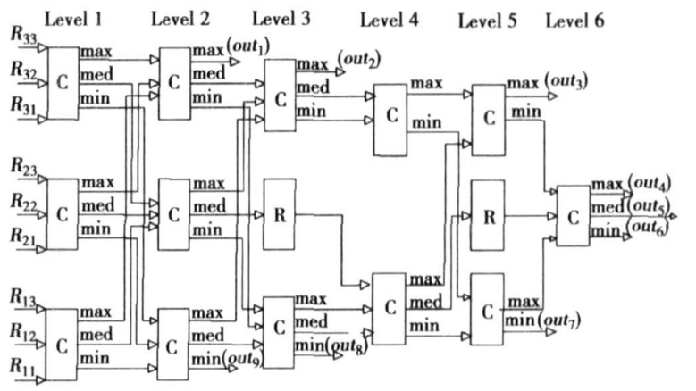
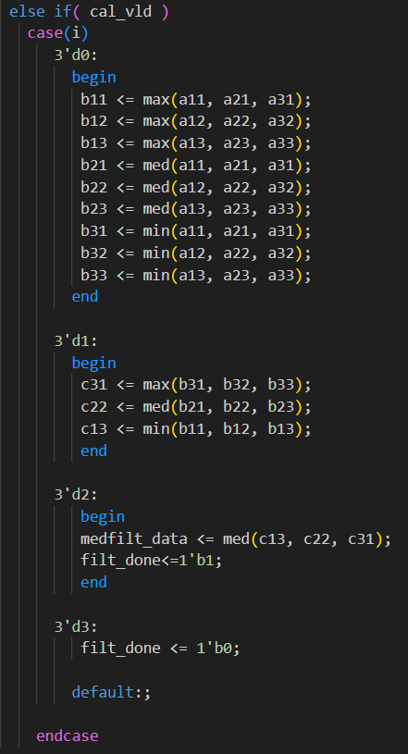
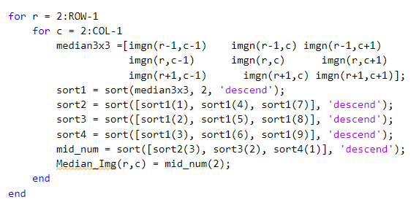
Median Filter Algorism
Logic of median filter
8
Verilog of median filter
Matlab median filter code

Slide 9
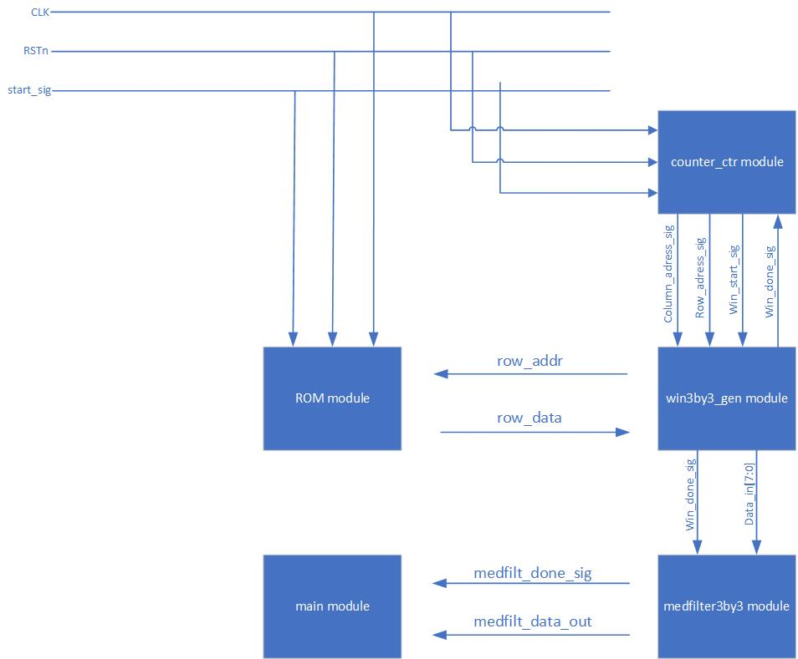
Flow Chart
Counter module
Window generation module
Median filter module
9

Slide 10
03
Project Procedure
10

Slide 11
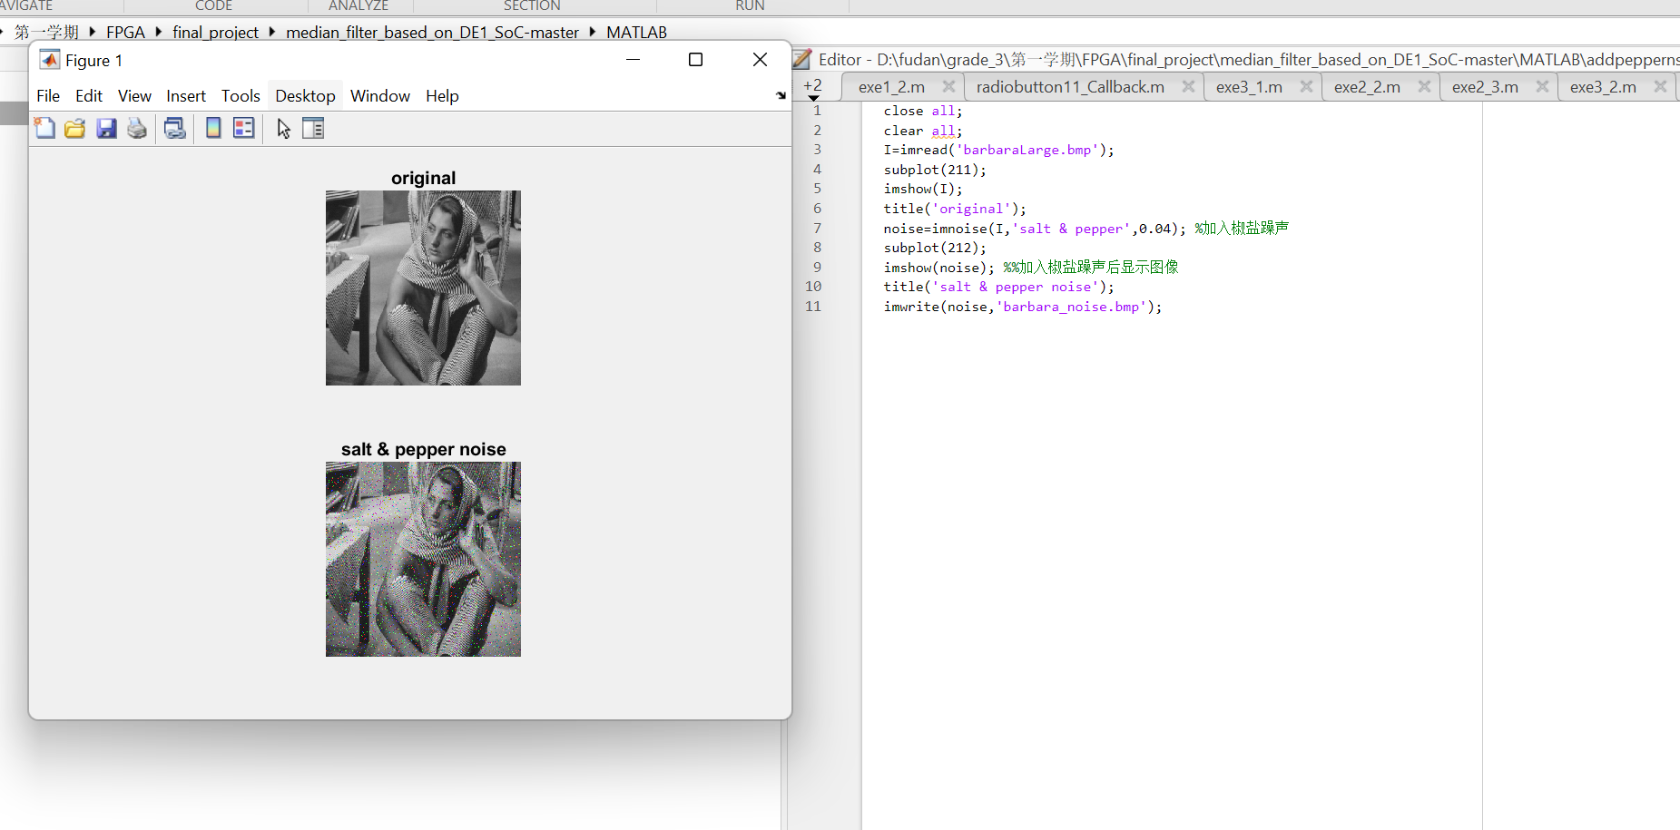
Matlab
Convert color image to grayscale
Add salt-and-pepper noise
11

Slide 12
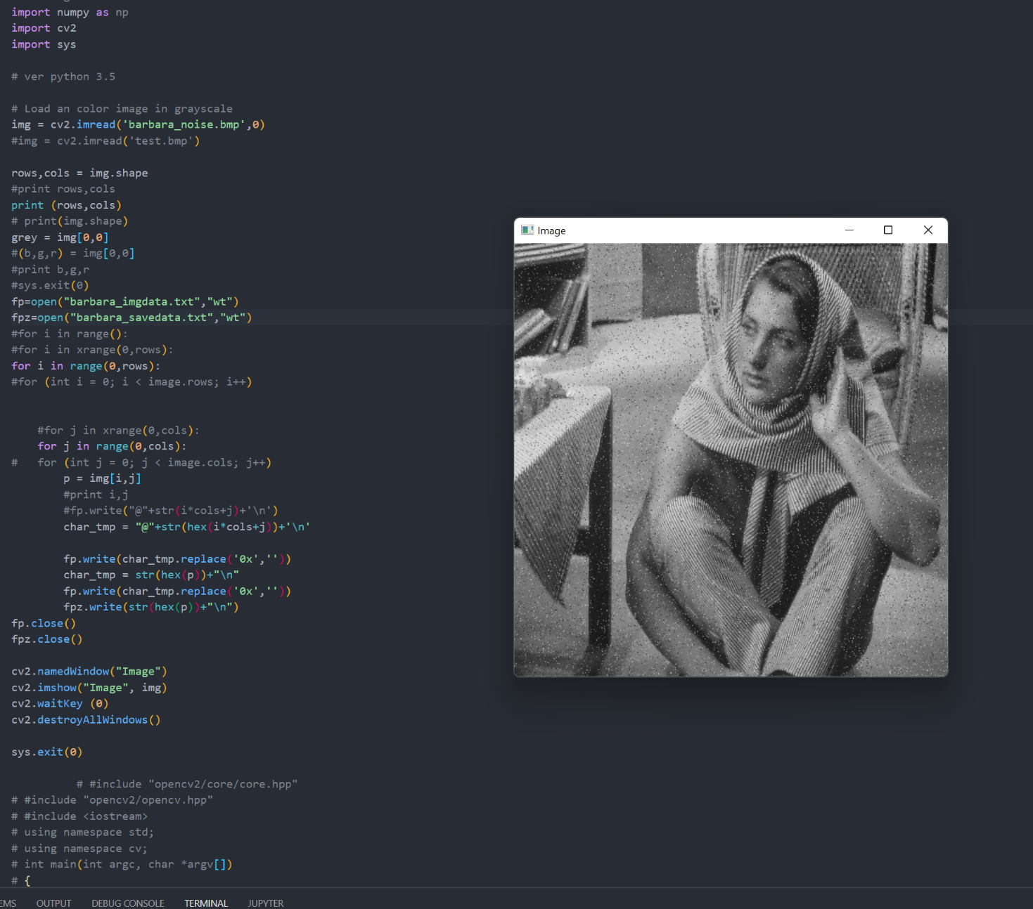
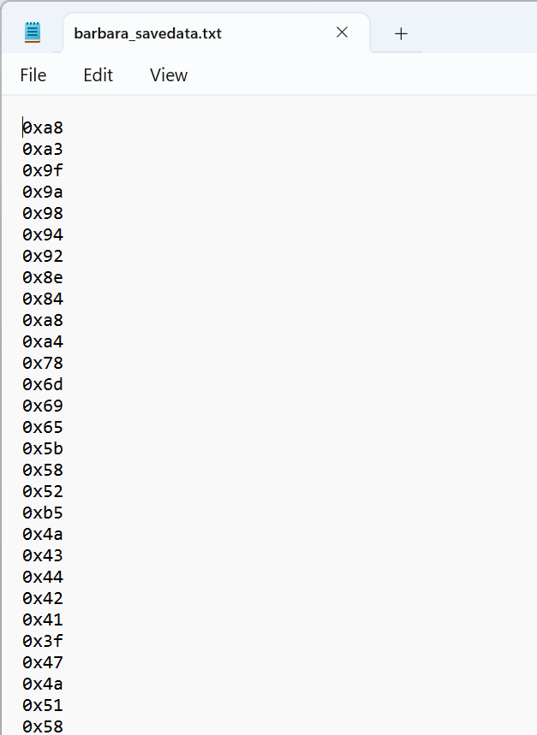
Python
Python (by OpenCV2)
Convert .bmp format to .txt files
Save to ‘savedata.txt’ (input of the verilog)
12

Slide 13
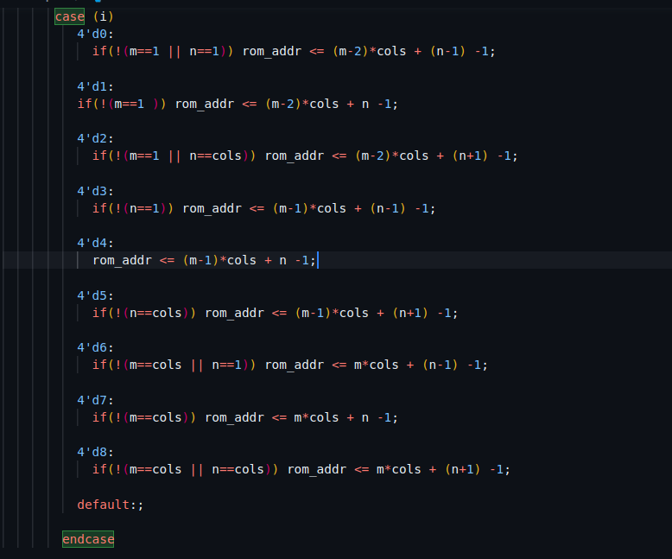
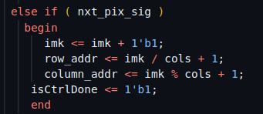
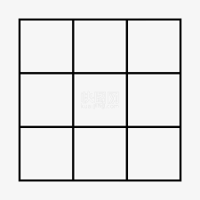
Verilog: find data address
13

Slide 14
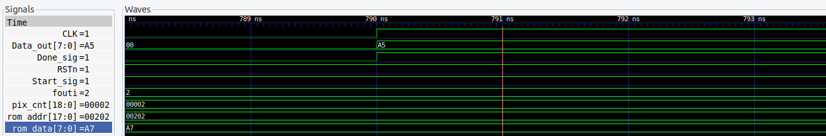
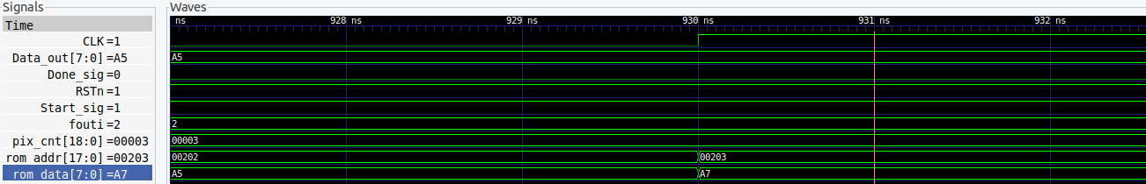
ModelSim
Running RTL Simulation
Implementing median filter function through software
14

Slide 15
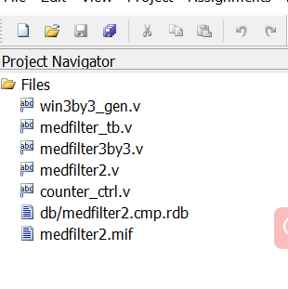
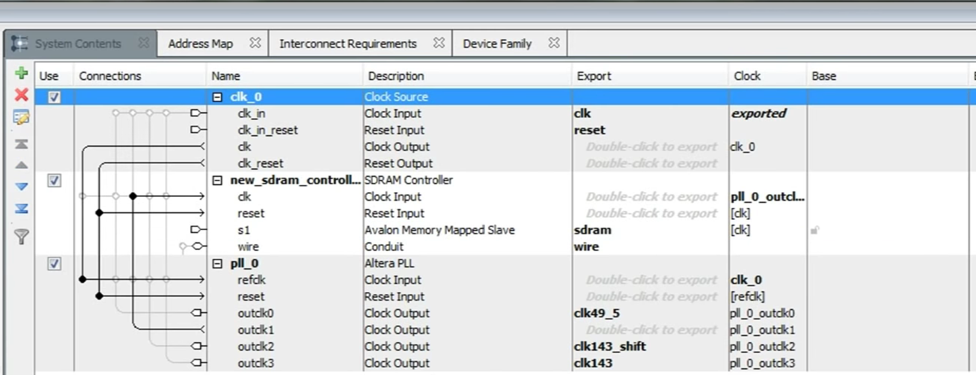
Quartus ii
15

Slide 16
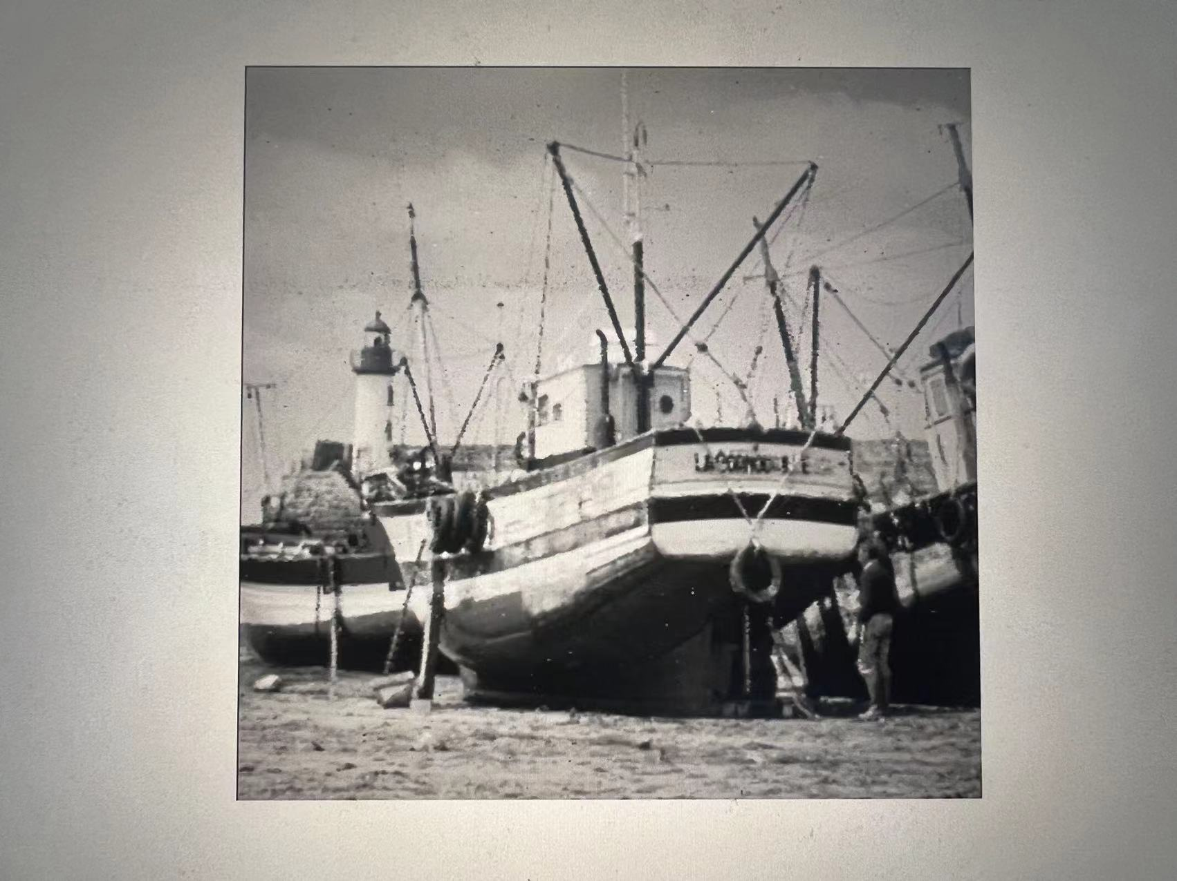
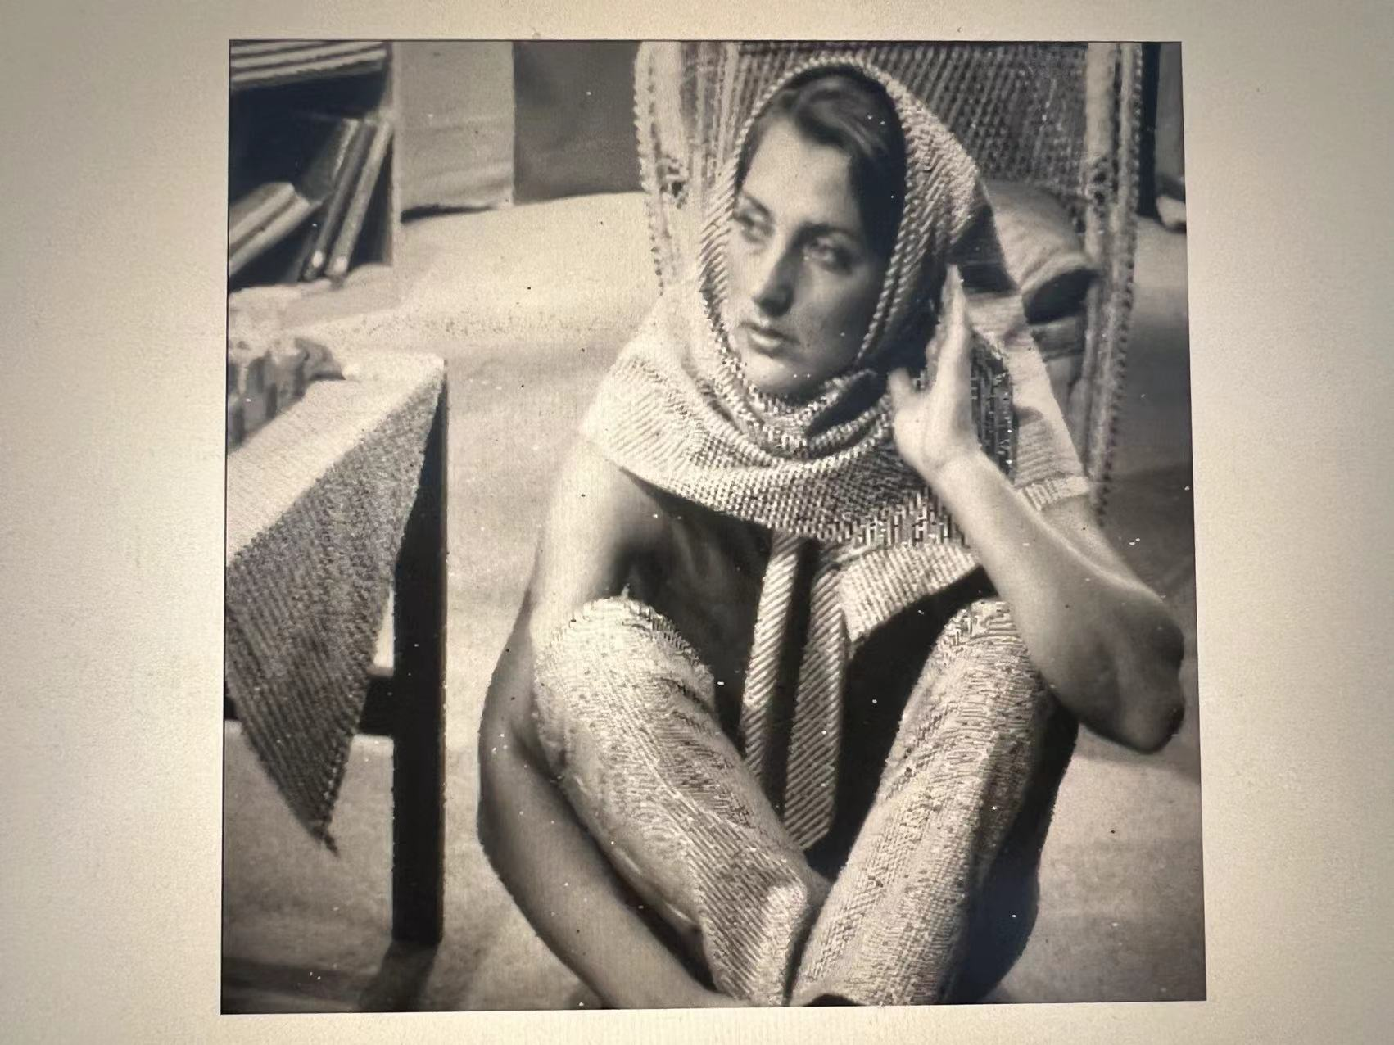
Board Result
16

Slide 17
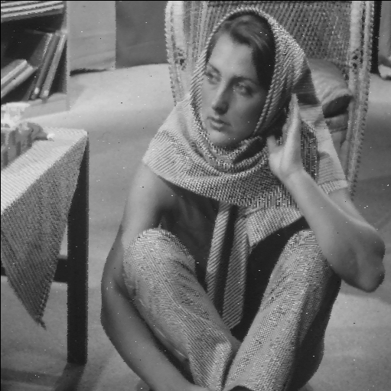
Result comparison
Both effectively removing the impact of salt-and-pepper noise
A slight difference between: the result from board is a little brighter.
Potential reason:
1 Fixed-point Arithmetic
2 Image Processing Libraries
Result from board
Result from Matlab
17

Slide 18
04
Problem and Solutions
18

Slide 19
Problems and Solutions
Processing with pixels on the boundaries
Processing with data in Verilog code
(Convert .bmp format to .txt files)
19

Slide 20
Thanks For
Watching!
20

